Slide 1
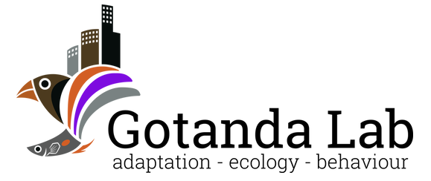

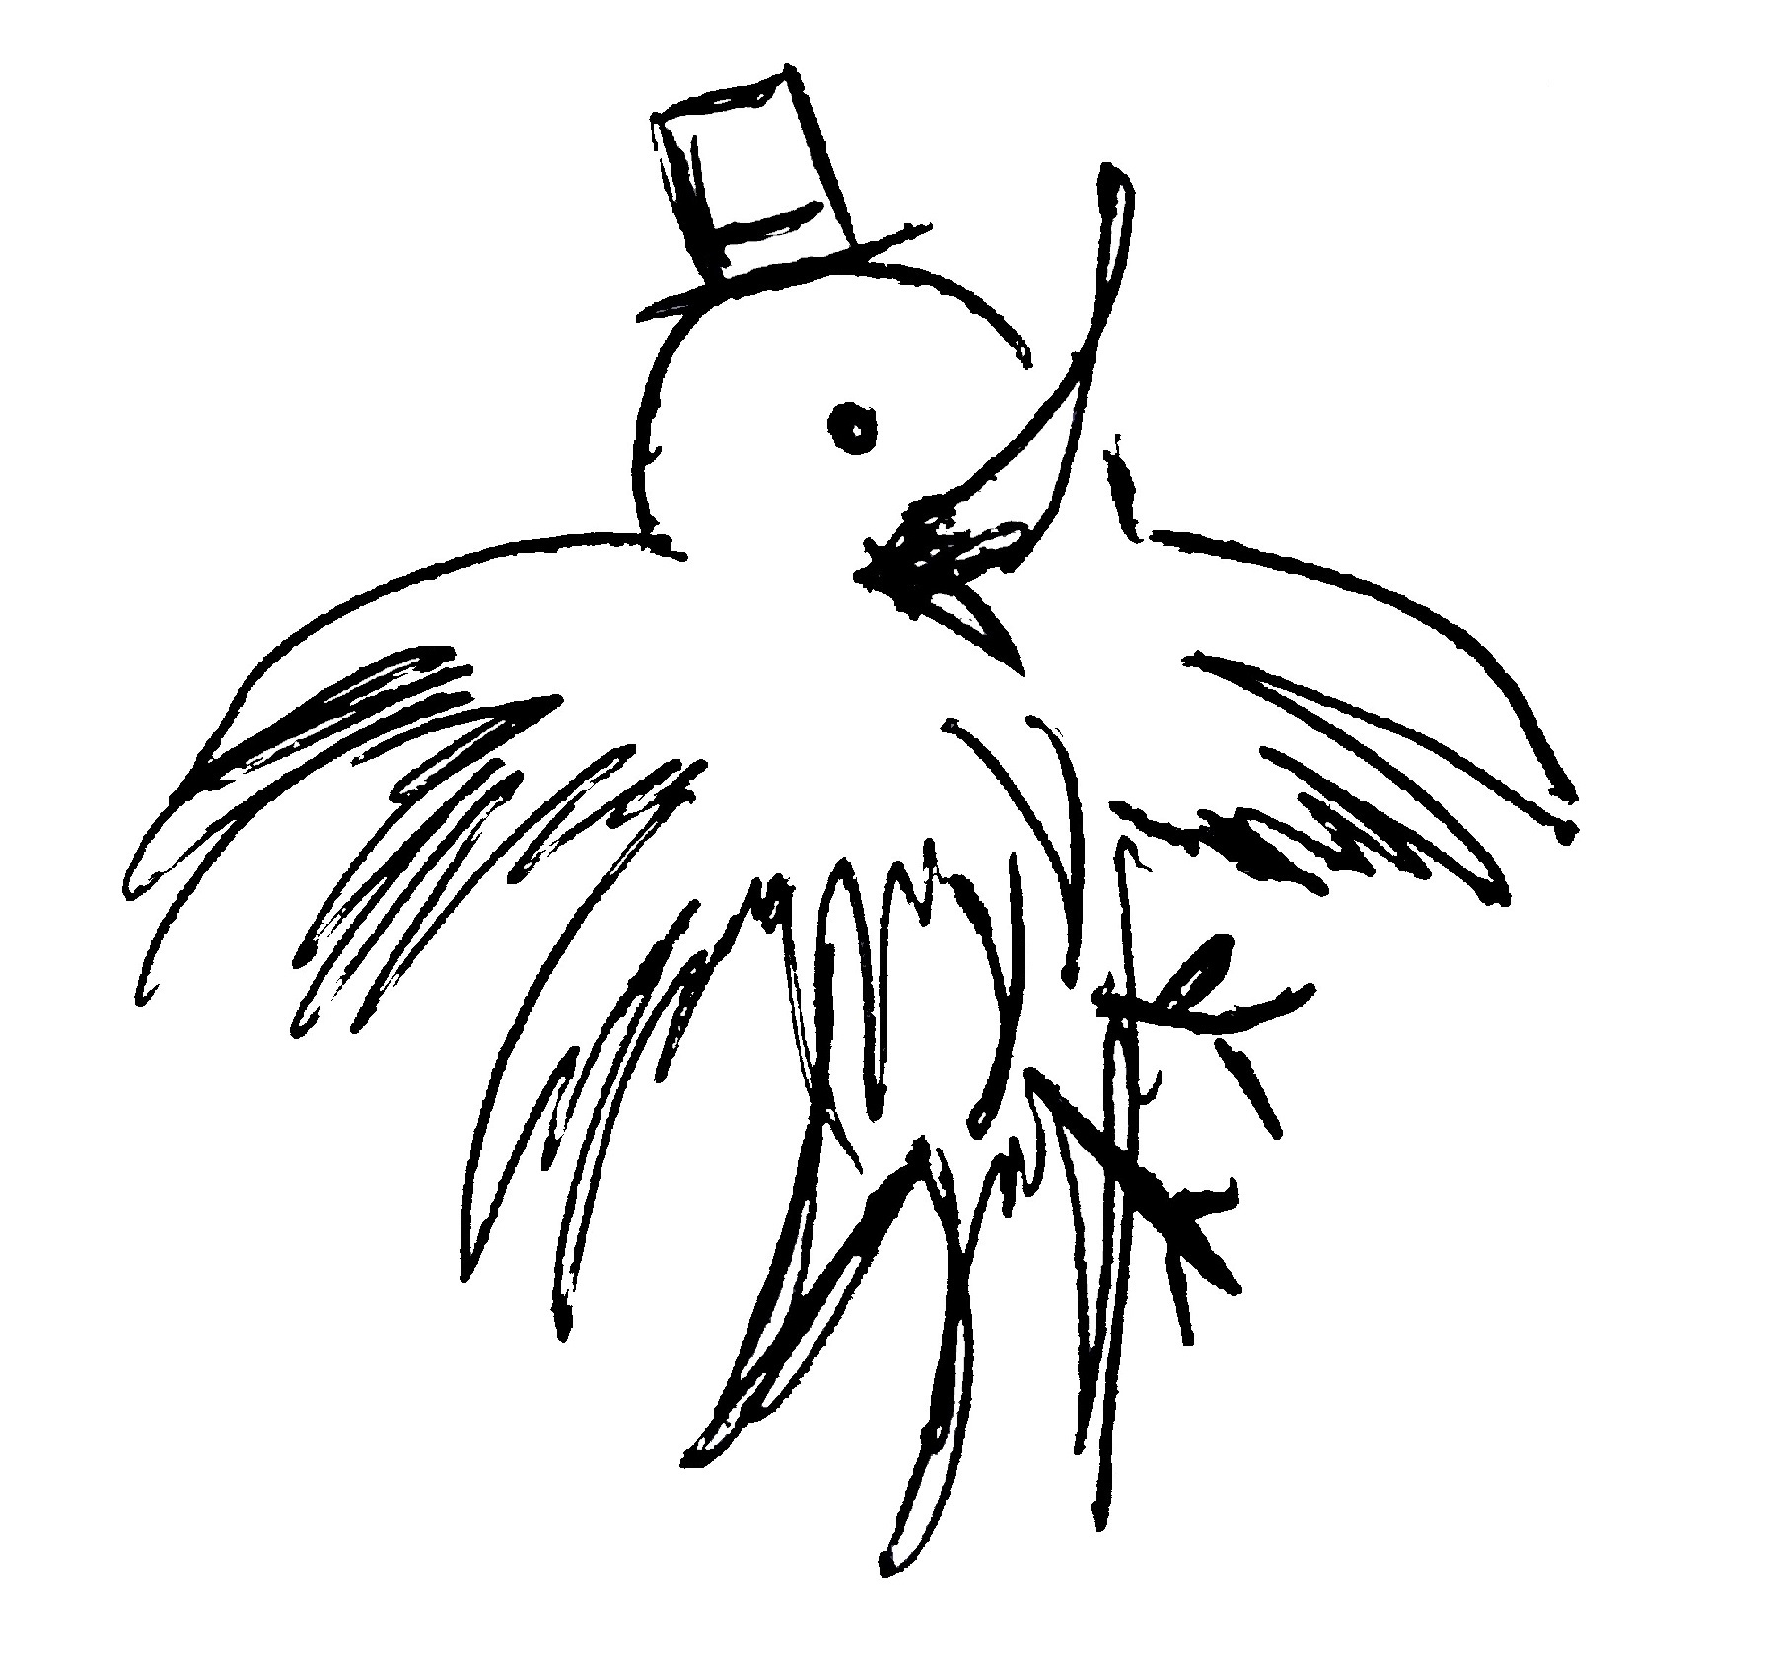
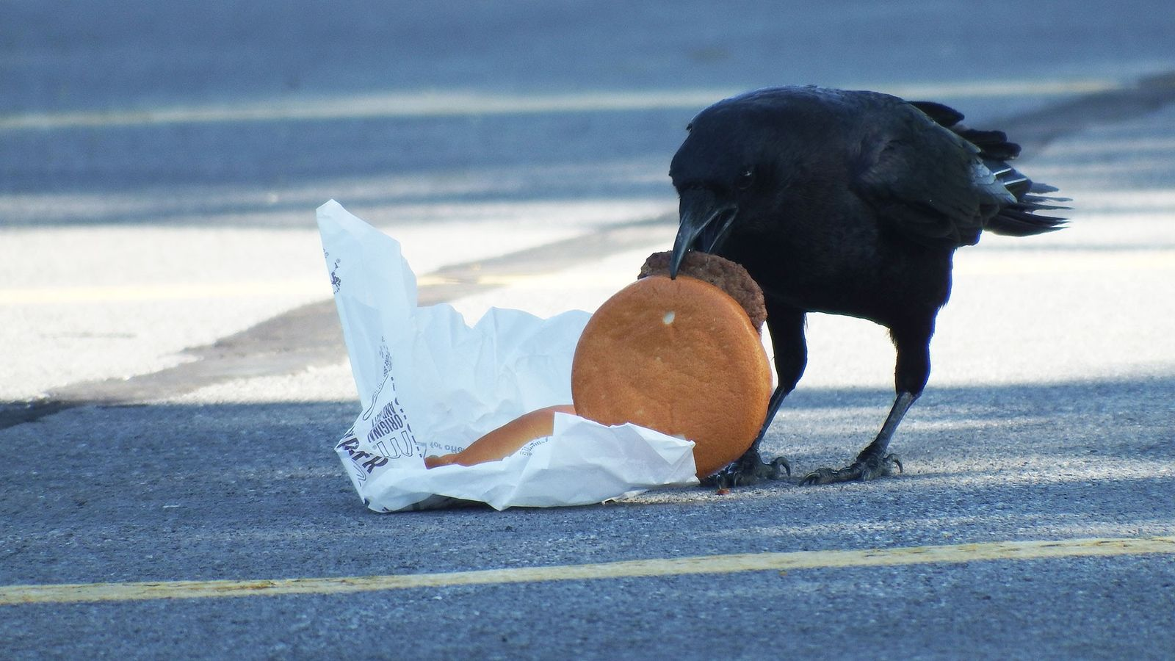
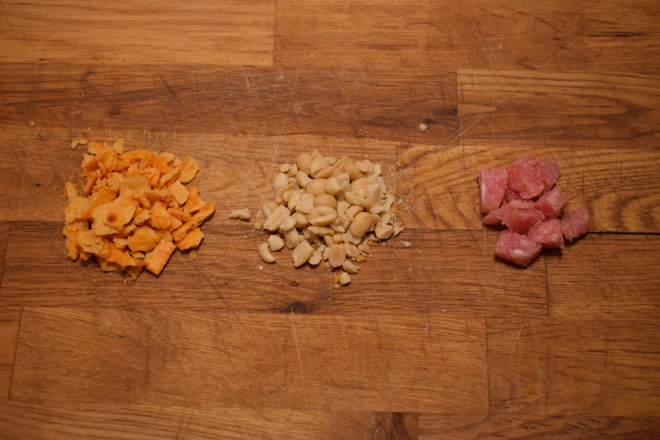
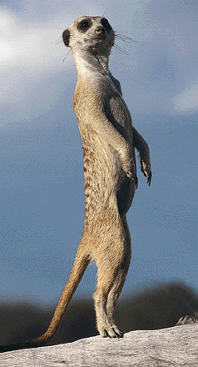
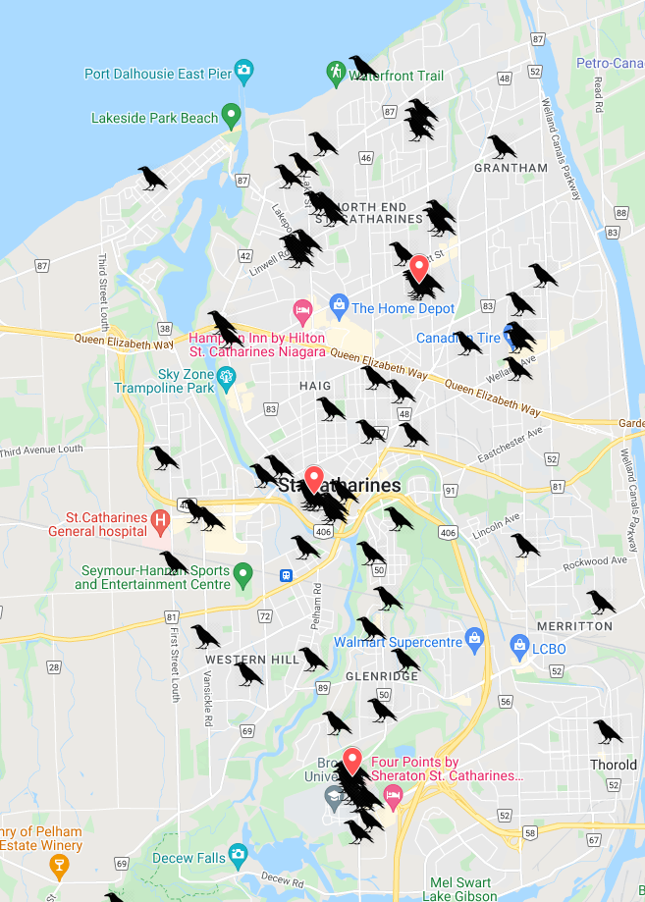
Urbanization and social antipredator behaviour in American crows Alex Popescu Department of Biological Sciences, Brock University
Black-clad city dwellers
Methods
Experimental design:
Fully crossed experiment consisting of supplemental feedings of varying quantity and quality.
Individual and social antipredator behaviours will be quantified.
Comparisons will be made between crow populations across differing levels of urbanization and human density.
Testing periods:
Tests during dawn (6-9am) and dusk (5-8 pm)
30-minute recording of crows foraging
Two sites per testing period, all sites tested each day
Sample size and replication:
Each treatment combination will be replicated 6 times.
3 replicates in each testing period
3 testing sites per month
Testing period from May to September
Up to 270 foraging events will be observed.
Sample size will depend on the presence of crows and weather during the testing period.
Treatment groups
American crows - Corvus brachyrhynchos
Social species exhibiting multiple social behaviours.
Highly adapted to living in urban settings.
Increased abundance in urban areas.
Figure 2: One portion of each type of food used during the experiment from left to right:
Low quality – Cheez-its
Medium quality – Peanuts
High quality – Meat morsels
Adaptations to urban life
Can includes changes in:
Foraging behaviour (e.g. preference for human foods)
Antipredator behaviour (e.g. decreased wariness of humans)
Adaptations to urban living have been observed in avian (e.g. pigeons, seagulls, house sparrows) and non-avian species (e.g. squirrels, raccoons, skunks).
These adaptations reflect the individual’s perception of their environment, and might optimize their fitness in urban settings.
Yet, while changes at the individual level have oft been observed, changes in social behaviours have not been investigated to the same extent.
Test food will be crushed or cut to be similar in size and pre-portioned into 10g portions. Three food quantities will be used:
Low quantity – 1 Portion (10g)
Medium quantity – 3 Portions (30g)
High quantity – 5 Portions (50g)
Food will be evenly dispersed by hand, each portion spread one step apart to avoid clumping.
Social antipredator behaviour
Testing sites
.
Measurements
Social antipredator behaviour – Sentinel behaviour
Proportion of foraging duration with a sentinel present
Proportion of foraging events with a sentinel present
Mean duration of sentinel bouts
Individual antipredator behaviour
Number of “Stop–Look–Restart” performed by foragers
Predictors
Trade-off
Insufficient vigilance or foraging efficiency increases the risk of predation and starvation, respectively.
Social antipredator behaviour
Minimize costs of vigilance to individuals in a social group.
Increased safety from potential threats.
Constant vigilance and sentinel behaviour
One individual watching over the other members of the group.
All individuals benefitting from the presence of a sentinel
Sentinel individual incurs costs of vigilance on foraging efficiency.
Crowkémon Go
Crowd-sourcing initiative
Citizen scientists reporting crow sightings in the Niagara region.
Used to select areas of high crow density
Site selection
3 sites selected 3 weeks prior to testing period
Sites sufficiently distanced to avoid pseudo replication
Group size
Distance from cover
Area type (urban, non-urban)
Human density
Number of foraging disturbances
Implications
Changes in social behaviour can impact fitness
Social behaviour is costly when not needed.
Changes in social behaviour can therefore contribute to the success of urbanized social species.
How social behavioural responses contribute to the success of species in urban areas is still poorly understood.
This experiment will provide insights into how American crows might change their behaviours in response to their environment at the social level
Can help predict how other urbanized social species might respond to the rapid, global increase in urbanization
Figure 1: Crowkémon Go in St. Catharines. Crow markers represent individual spotting events. Red markers show May testing sites.
The propensity of individual to participate in sentinel behaviour can be affected by its environment. Individuals can choose to either forage individually or socially.
Objectives and Hypothesis
Objective: To observe changes in social antipredator behaviour in areas of varying levels of urbanization and proximity to humans.
Hypothesis: American crows in urban areas and in greater proximity to humans will have altered social antipredator behaviour.
Predictions: Likely due to decreased wariness of humans and the presence of fewer predators, urban crows are predicted to forage in smaller groups, and in a more individualistic manner.
Pre-test baiting
Testing sites will be regularly “baited” for 3 weeks prior to the testing period.
To increase the likelihood of crows being present during the testing phase.
Supplemental feedings and playing feeding calls on a speaker
Reinforce the association between the location and the presence of food.
Familiarize crows with the presence of the observer.
Acknowledgements
I would like to thank Dr. Kiyoko M. Gotanda, Dr. Anne B. Clark, Ian Gordon, Dr. Liette Vasseur, Albert Wu and Lilianne Caron for their help, advice and support.

